Slide 1

An Heuristic Approach for the G-VRP
Paulo Costa | Stefano Mauceri
Something about Xreso
Academic Supervisor: Dr. Paula Carroll
Paulo Costa | Stefano Mauceri
Supervisor: Dr. Paula Carroll
Green VRP Problem – Sponsor: Xpreso
External Supervisor: Fabiano Pallonetto

Slide 2

Introduction

Slide 3

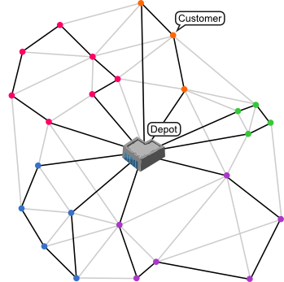


G-VRP General Assumptions
Green Vehicle Routing Problem (G-VRP)
Definition:
Deliver Goods to Customers Minimising Fuel Consumption and/or Greenhouse Gas Emissions;
Leave And Return From The Depot.
Motivations:
Environment / Social Benefits;
Operation Efficiency (e.g.. No. of vans, Fuel)
Released in 2007

Slide 4
Our Approach
Literature Review
Data Analysis
Implement VRP and G-VRP Solving Algorithms
Population + Local Search ;
G-VRP - Fuel Emissions;
Accuracy test on a benchmark database
Apply the method on Xpreso’s database
Estimate the travel time and optimal route
Routes Contain Between 50 To 120 Deliveries.
Measurement/Comparison of the results
Recommendation/Analysis
G-VRP
Notes:
! Potential Risks
Apply the model on the real database;
No improvement in the final solution (tight constraints, no improvement in fuel emissions).
! Risk Mitigation
Apply and test the model on a benchmark database

Slide 5

Vehicle Routing Problem Timeline
1959
TIME DEPENDENT VRP
Cooke & Halsey ’66
PERIODIC VRP
Beltrami & Boden ‘74
MULTI DEPOT VRP & STOCHASTIC VRP
Tillman ‘69
DANTZIG AND RAMSER - CVRP
Published The First VRP Model In The Literature.
66-77
84-89
FLEET SIZE AND MIX VRP
Golden, Assad & Dahl ’84
GENERALISED VRP
Tsiligirides ’84
SITE DEPENDENT VRP
Nag ’86
95-06
GREEN VRP
Sibihi & Eglese ‘07
MULTI ECHELON VRP
Perboli, Tadeei & Vigo ’11
2007+
FUZZY VRP
Cheng, Gen & Tozawa ‘95
OPEN VRP
Powell‘00
VRP WITH LOADING CONSTRAINTS
Iori, Salazar-González & Vigo ‘03

Slide 6
Solution Approaches - Exact
Exact Approaches
Dynamic and Integer Programming;
NP-hard Combinatorial Optimisation Problem;
Too Slow For Practical Purposes.
Improvements
Column Generation
Master Problem: solved with a subset of variables;
Sub Problem: solved to reduce the cost of the candidate variable using dual variables.
Branch and Cut
LP Relaxation is solved;
Find integer solutions more quickly;
Branch and Bound and cutting planes are used to produce better integer solutions;
The problem is solved relaxing the integrality and subtour elimination constraints, and by generating them only when they are violated (Laporte et al., 1985)

Slide 7
Solution Approaches - Heuristic
Classical Heuristic Algorithms
Saving
Sequential Improvement
Sweep
Petal
Fisher and Jaikumar two-phase
Local Search:
2-opt
3-opt
Lin–Kernighan
Metaheuristic Algorithms
Local Search/Global Search
Tabu Search
Simulated Annealing
GRASP
Variable Neighbourhood Search
Large Neighbourhood Search
Population Search
Genetic Algorithm
Ant Colony Optimisation
x*

Slide 8

The Data

Slide 9





Data
Ex post – Statistical data
Around 40 drivers (per day)
Around 3000 deliveries (per day)
Over a period of 2 month
Latitude / Longitude Pairs
Parcels Weight
Actual Delivery Time
Driver Code
Postcode
Altitude

Slide 10








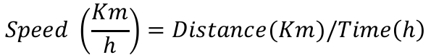
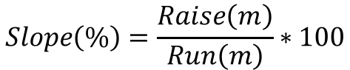
Distance Matrix
Distance
A
$$Speed \left(\frac{Km}{h}\right)=Distance(Km)/Time\left(h\right)$$
Travel Time
B
Postcodes
Altitude
$$Slope\left(\%\right)=\frac{Raise\left(m\right)}{Run\left(m\right)}∗100$$
Minimum Distance: 0.1 Km
Minimum Travel Time: 1 minute
⇒
Minimum Speed: 6 Km/h
Slope Range: [-6, 6] %

Slide 11

Distance Matrix
Distance
A
$$Speed \left(\frac{Km}{h}\right)=Distance(Km)/Time\left(h\right)$$
Travel Time
B
Postcodes
Altitude
$$Slope\left(\%\right)=\frac{Raise\left(m\right)}{Run\left(m\right)}∗100$$
Minimum Distance: 0.1 Km
Minimum Travel Time: 1 minute
⇒
Minimum Speed: 6 Km/h
Slope Range: [-6, 6] %

Slide 12










Distance Matrix
SYMMETRIC Vs ASYMMETRIC ROAD NETWORK
Many factors make the road network asymmetric
The impact on distance, slope, speed, directly influences our emissions model
Technical constraints require us to assume the road network as symmetric

Slide 13
Distance Matrix
SYMMETRIC Vs ASYMMETRIC ROAD NETWORK
A
B
≠
B
A
Solutions from Symmetric Matrices are on average +1% greater in terms of distance and emissions

Slide 14
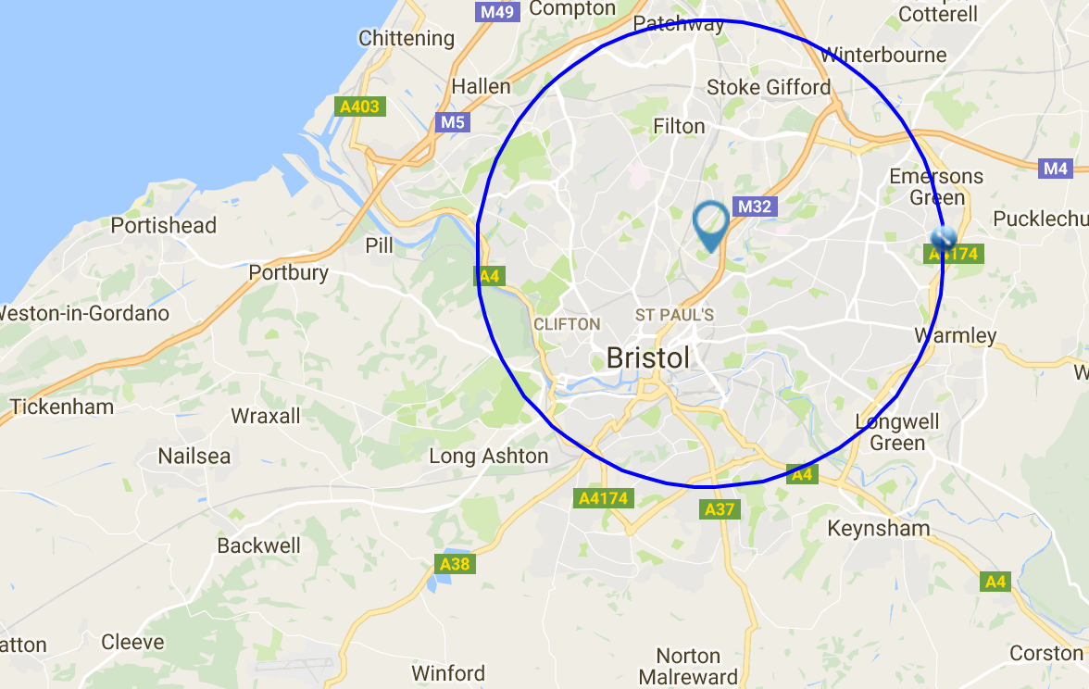
Road Network
BRISTOL, UK
BRISTOL – Road Network Features
Population : 428,000 people
Area : 110 Km²
Distance Depot/City Centre : 12.8 Km
Mainly Flat Area
DISTANCE
SPEED
μ : 2.4 Km
Median : 1.85 Km
σ : 2.55 Km
μ : 23.52 Km/h
Median : 24.00 Km/h
σ : 6.97 Km/h
SLOPE
EMISSIONS
μ : 0.0 %
Median : 0.0 %
σ : 1.23 %
μ : 721 g Median : 602 g
σ : 624 g

Slide 15
Road Network
BRISTOL, UK
BRISTOL – Road Network Features
Population : 428,000 people
Area : 110 Km²
Distance Depot/City Centre : 12.8 Km
Mainly Flat Area
DISTANCE
SPEED
μ : 2.4 Km
Median : 1.85 Km
σ : 2.55 Km
μ : 23.52 Km/h
Median : 24.00 Km/h
σ : 6.97 Km/h
SLOPE
EMISSIONS
μ : 0.0 %
Median : 0.0 %
σ : 1.23 %
μ : 721 g Median : 602 g
σ : 624 g

Slide 16
Emission Models
CO₂

Slide 17

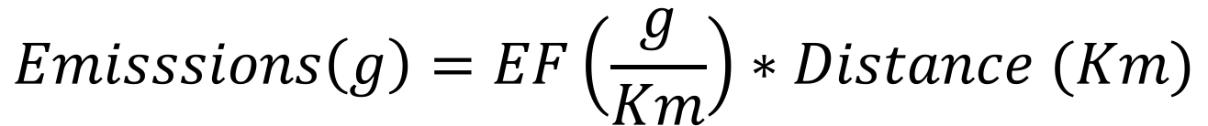
Emission Models
Basic Relationship
$$Emisssions\left(g\right)=EF\left(\frac{g}{Km}\right)∗Distance (Km)$$
Vehicle Category : Light duty vehicle
Fuel Type : Diesel
Weight Unloaded : <= 3.5 Tons
Weight Loaded : <= 7.5 Tons

Slide 18
Emission Models
Basic Relationship
$$Emisssions\left(g\right)=EF\left(\frac{g}{Km}\right)∗Distance (Km)$$
Vehicle Category : Light duty vehicle
Fuel Type : Diesel
Weight Unloaded : <= 3.5 Tons
Weight Loaded : <= 7.5 Tons

Slide 19
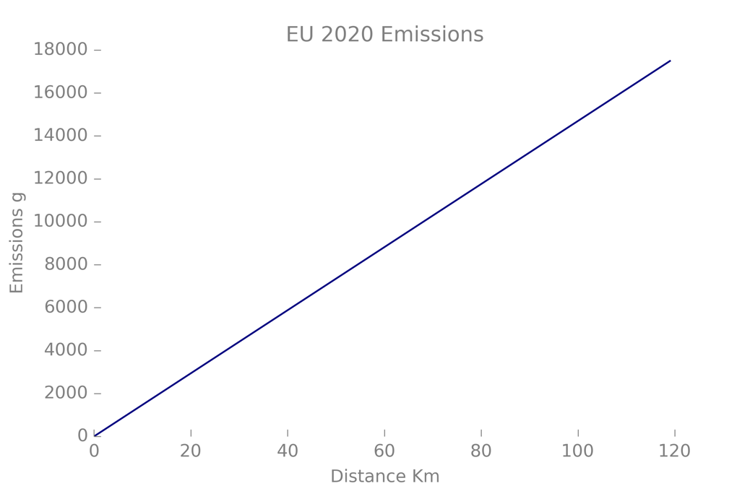
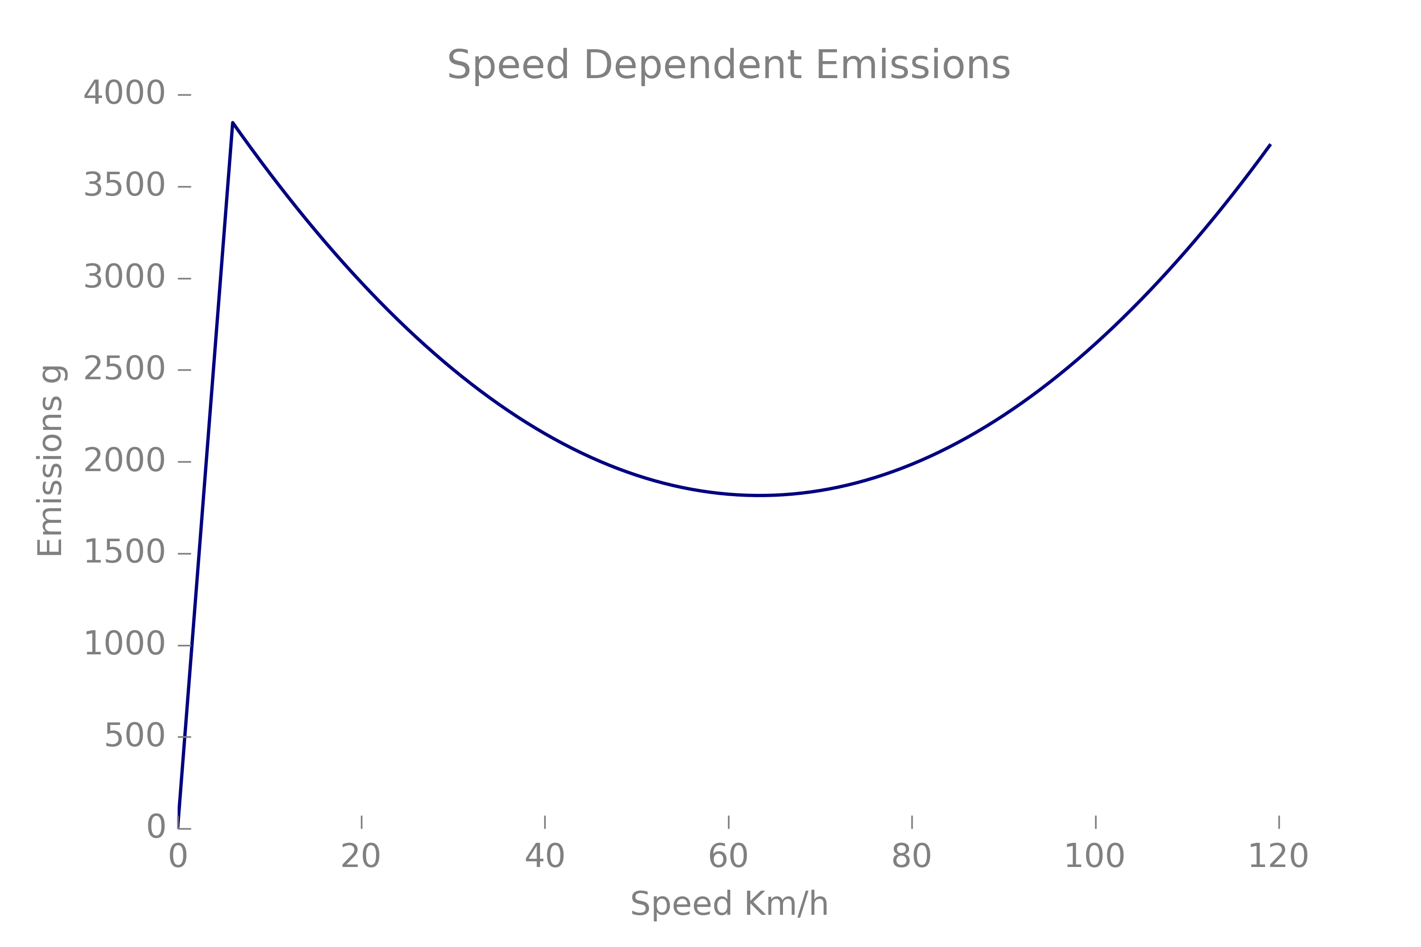

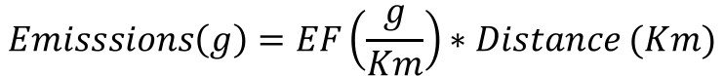
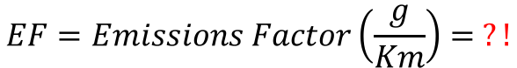
Emission Models
Basic Relationship
$$Emisssions\left(g\right)=EF\left(\frac{g}{Km}\right)∗Distance (Km)$$
$$EF=Emissions Factor\left(\frac{g}{Km}\right)= ?!$$
EU20-EM
SP-EM
GD-EM

Slide 20
Emission Models
EU20-EM | EUROPEAN EMISSIONS TARGET

Slide 21
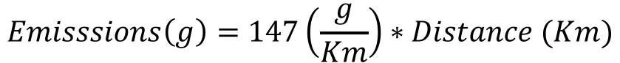
Emission Models
EU20-EM | EUROPEAN EMISSIONS TARGET
$$Emisssions\left(g\right)=147\left(\frac{g}{Km}\right)∗Distance (Km)$$
Linear in the distance
Not used for optimisation
Future legal upper bound for emissions

Slide 22
Emission Models
SP-EM | AVERAGE SPEED DEPENDENT EMISSIONS

Slide 23
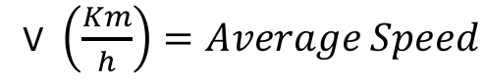
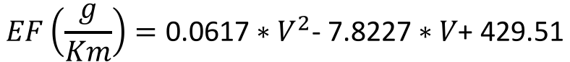
Emission Models
SP-EM | AVERAGE SPEED DEPENDENT EMISSIONS
$$EF\left(\frac{g}{Km}\right)=\text{0.0617}∗V^{2}\text{− 7.8227}∗V\text{+ 429.51}$$
V $\left(\frac{Km}{h}\right)=Average Speed$
Nonlinear
Used for optimization
Baseline of the GD-EM
Minimum speed exogenously set to 6 Km/h
Consequently minimum EF = 384.8 g/Km

Slide 24
Emission Models
GD-EM | AVERAGE SPEED + GRADIENT + WEIGHT DEPENDENT EMISSIONS

Slide 25
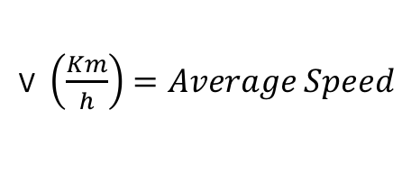
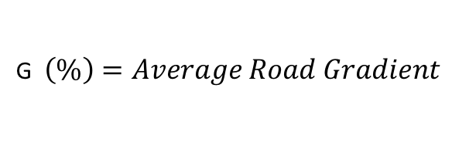
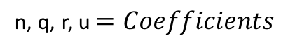
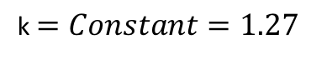
Emission Models
GD-EM | AVERAGE SPEED + GRADIENT + WEIGHT DEPENDENT EMISSIONS
$$Adjusting EF=k+n∗G+q∗G2+r ∗V +\frac{u}{V}$$
V $\left(\frac{Km}{h}\right)=Average Speed$
G $\left(\%\right)=Average Road Gradient$
n, q, r, u $=Coefficients$
k $=Constant=1.27$
Emissions are on average 15 % higher than SP-EM
The impact of slope is marginal in our applications
k allows to set the impact of load

Slide 26

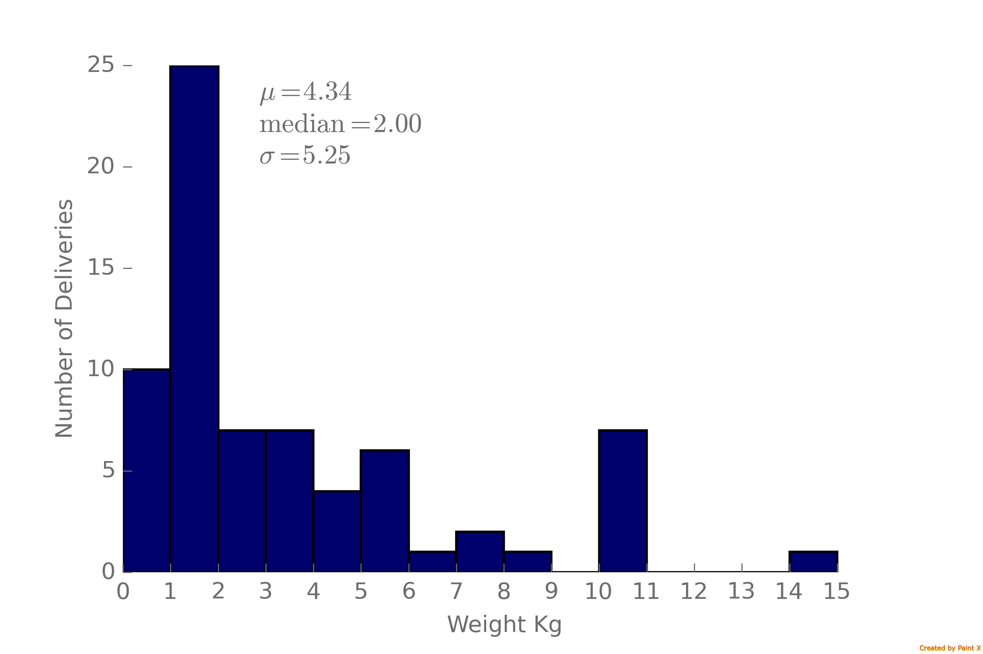
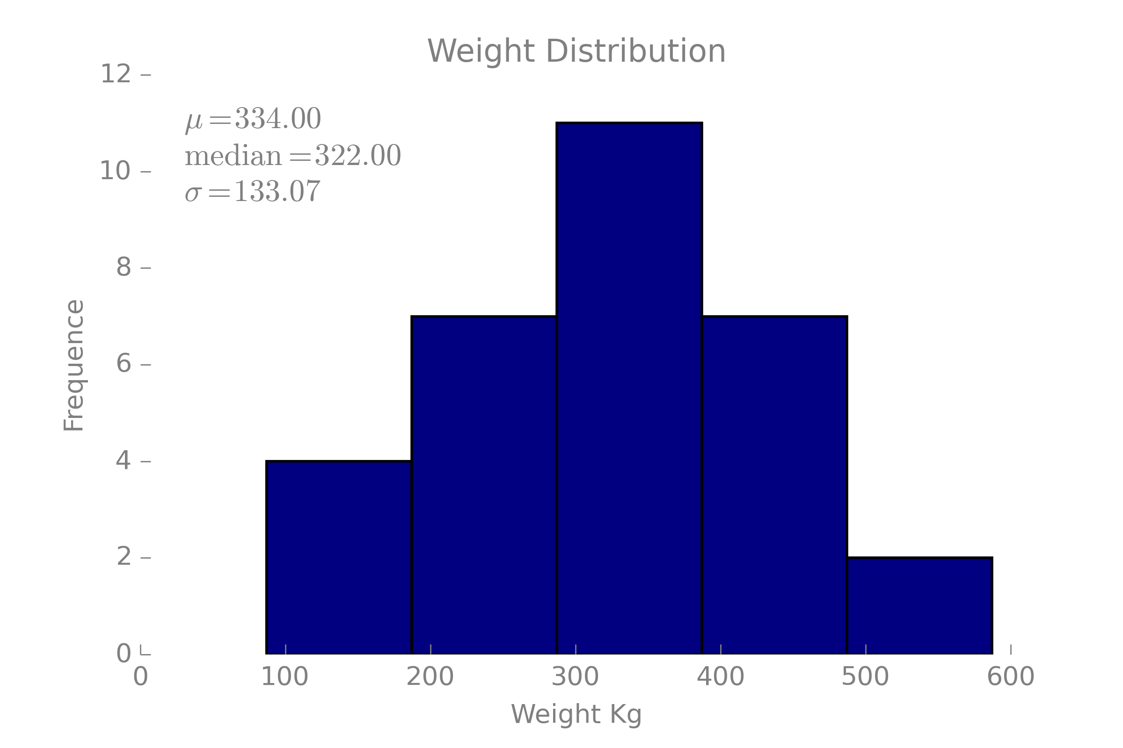
Load Model
TOTAL WEIGHT
SINGLE PACKAGE WEIGHT

Slide 27
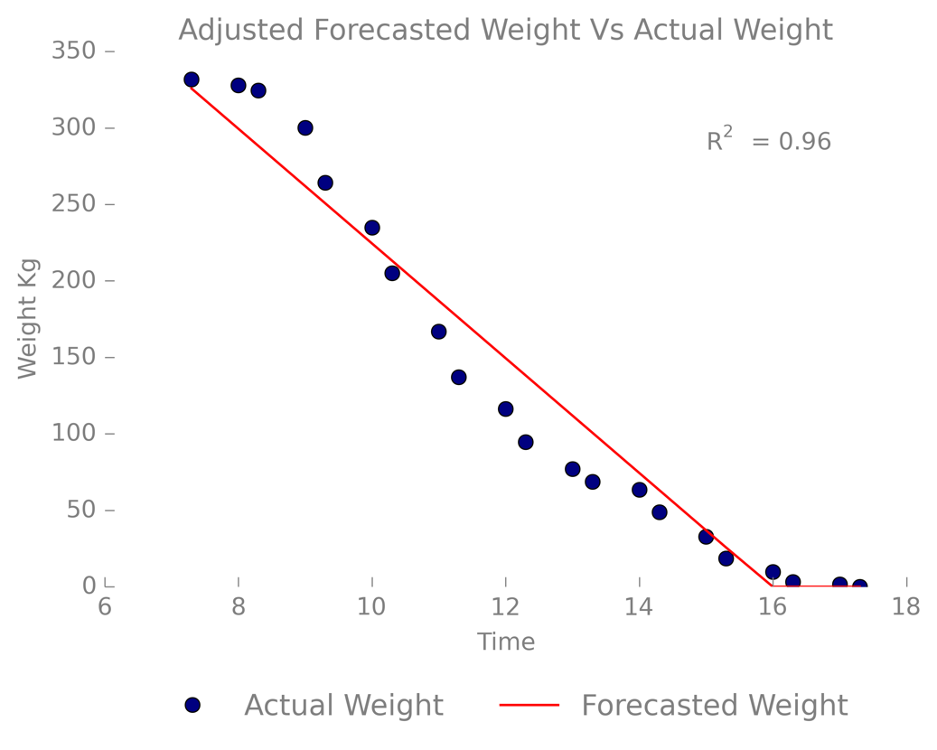
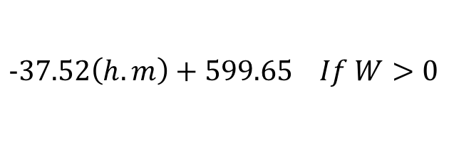
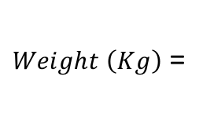
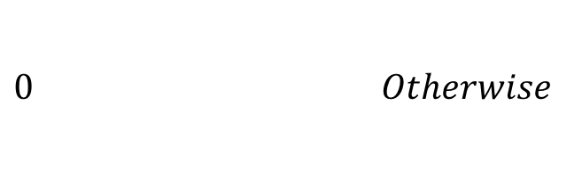
Load Model
┼
=
┼
CO₂
$$−37.52\left(h.m\right)+599.65 If W>0$$
$Weight \left(Kg\right)$ =
$0 Otherwise$
Good coefficient of determination (on average)
Impact on the final emissions too low
Hard to combine time and stops
Good insight for future research

Slide 28

Heuristic

Slide 29

Heuristic: Genetic Algorithm (TSP)
Motivations
Drivers are assigned to regions by companies. Solve a TSP instead of a VRP;
Apply a simple and hybrid heuristic on a real-world database (Big Problem);
Local Search + Population.
n-TSP: GA based implementation to solve a TSP for each driver.
TSP Permutation Chromosomes;
Fitness ← Tour Cost;
Small Populations / No Clones Allowed / High Elitism;
Inclusion of good heuristics solutions in the initial population;
Mutation: LS Search + Stochastic 3-OPT
Incremental Population
Exploration + Restarts

Slide 30
Heuristic: GA (TSP)
OX Crossover
Local Search
1. Remove i then insert it after j.
2. Remove (i , i + 1) and insert them after j.
3. Remove (i , i + 1) and insert (i + 1, i) after j.
4. Swap i and j.
5. Swap (i , i + 1) and j.
6. Swap (i , i + 1) and (j , j + 1).
7. 2-OPT move between (i , i+1) and (j , j +1), resulting a tour with edges
(i , j + 1) and (i + 1 , j).
P₁: 1 2 3 5 6 4 7 8 10 11 9
P₂: 8 9 2 3 1 7 5 11 10 4 6
C₁:
3 1 7
5 6 4
11 10 8 9 2
Stochastic: 3-OPT algorithm is called to attempt improvements. It swaps edges (i , i + 1), (j , j + 1), (k , k + 1) into a feasible permutation.

Slide 31
Heuristic: GA (TSP) Main Phase
Population Initialisation
Main Phase
(a) Generate the first solution (P1) using the CW heuristic. Add to the population.
(b) Generate the second (P2) solution using the NN heuristic. If F(P1)
is equal to F(P2) skip. Otherwise, insert it in the population.
(c) Generate the third (P3) solution using the RI heuristic. If F(P1) is equal to F(P3) or F(P2) is equal to F(P3) skip. Otherwise, insert it in the population.
(d) For the rest of the population generate random tours Pk. If F(Pk) is not in the population, insert. Do until the length of the population reaches n. Sort the population in increasing order.
While alpha < alpha_max and beta < beta_max do:
i. Select two parents P1 and P2 by binary tournament.
ii. Apply OX and generate C1 and C2.
iii. Select one child randomly C, among (C1, C2).
iv. Select r = random. If r < pm then C: Mutation(C).
v. Select k = random.integer(n/2; n).
vi. If F(C) not in the population and F(C) < F(Pk). Insert C inthe population at position k. alpha = alpha+ 1. Sort the population.
vii. If P1 has not changed. beta = beta + 1
Notes:
Take advantage of the xpreso database -> Solvers that previously solve the problem
Try to improve their solution using the taffic congestion data / fuel emissions
Why not the rest?
Exact – Too time consuming
Not practical for more than 75 nodes
Other heuristics-
Population searches – Our case is to improve a known solution to a possible better optimum point
Fast , feasible 3 months, usable.

Slide 32
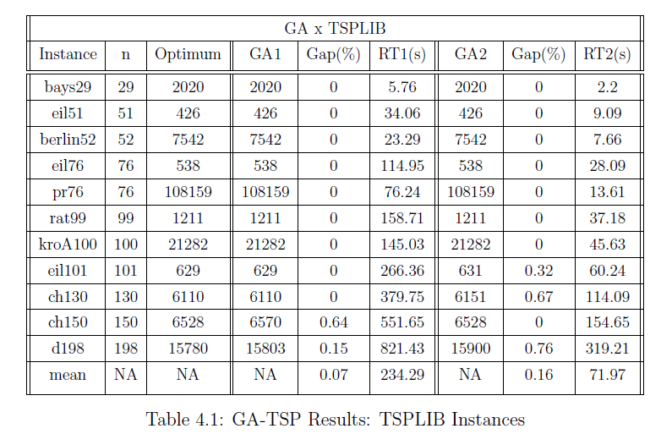
Heuristic: GA(TSP) Benchmark
Notes:
Take advantage of the xpreso database -> Solvers that previously solve the problem
Try to improve their solution using the taffic congestion data / fuel emissions
Why not the rest?
Exact – Too time consuming
Not practical for more than 75 nodes
Other heuristics-
Population searches – Our case is to improve a known solution to a possible better optimum point
Fast , feasible 3 months, usable.

Slide 33
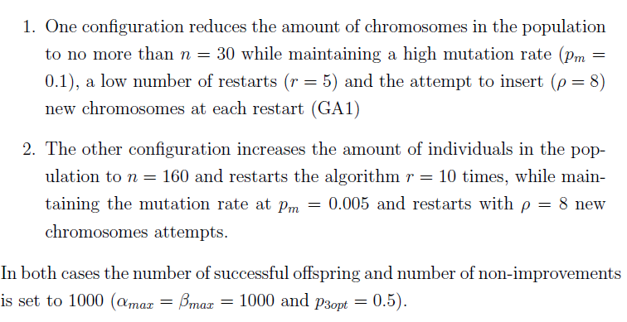
Heuristic: GA(TSP) Benchmark
GA Configurations
Benchmark Results
Notes:
Take advantage of the xpreso database -> Solvers that previously solve the problem
Try to improve their solution using the taffic congestion data / fuel emissions
Why not the rest?
Exact – Too time consuming
Not practical for more than 75 nodes
Other heuristics-
Population searches – Our case is to improve a known solution to a possible better optimum point
Fast , feasible 3 months, usable.

Slide 34
Heuristic: GA (VRP)
Motivations
TSP solutions can be suboptimal;
Solving a small VRP in a given region instead of a big VRP.
VRP: GA based implementation to solve VRP.
TSP Permutation Chromosomes + Split Procedure break a TSP-tour into smaller Trips;
Fitness ← Tour Cost;
Small Populations / No Clones Allowed / High Elitism;
Inclusion of good heuristics solutions in the initial population;
Mutation: 2OPT + Swap Nodes;
Time constraints: Travel Time + Service time < 7 hours

Slide 35
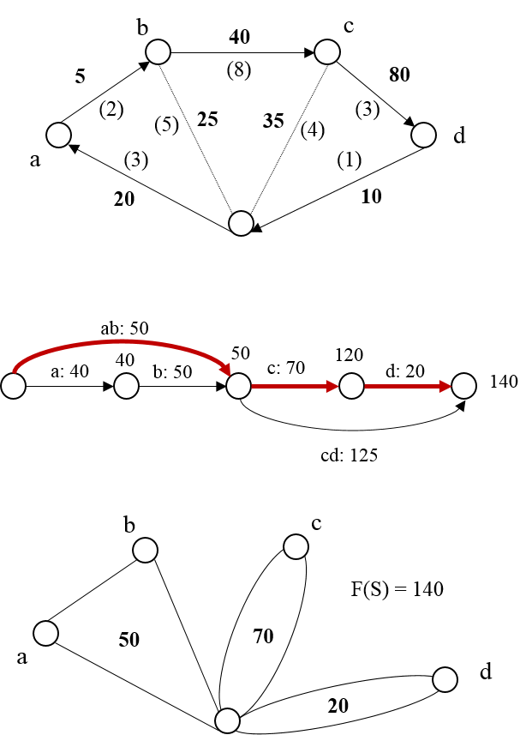
Heuristic: GA (VRP)
Split Procedure : Modification of (Prins,2001)
Create an underlying Graph H.
H has all the feasible trips (S) between nodes i and j. It contains n + 1 nodes indexed from 0 to n.
To find the best trips in terms of cost we need to find the shortest path in H.
Example: (ab → c → d)
Rebuild the trips using the shortest path in H.
The theory guarantees that if we find a suitable chromosome, then its trips will be created optimally each time.
Our implementation uses time instead of loads to break the tours.

Slide 36
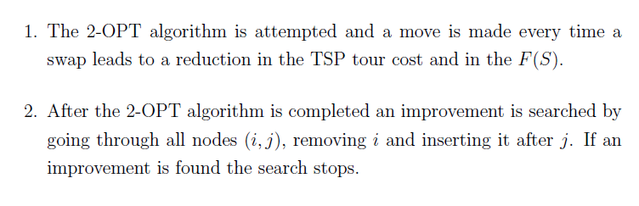
Heuristic – GA (VRP): Mutation
Simpler Local Search
Notes:
Take advantage of the xpreso database -> Solvers that previously solve the problem
Try to improve their solution using the taffic congestion data / fuel emissions
Why not the rest?
Exact – Too time consuming
Not practical for more than 75 nodes
Other heuristics-
Population searches – Our case is to improve a known solution to a possible better optimum point
Fast , feasible 3 months, usable.

Slide 37
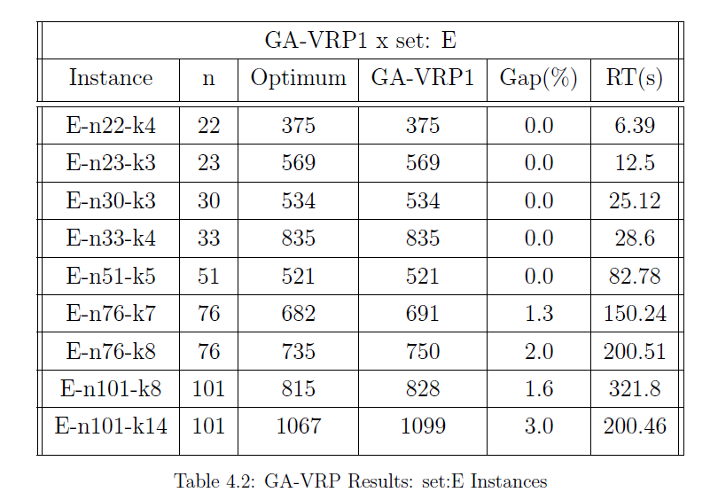
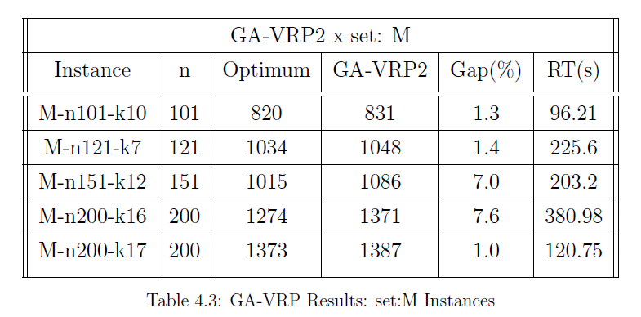
Heuristic: GA (VRP) Benchmark

Slide 38
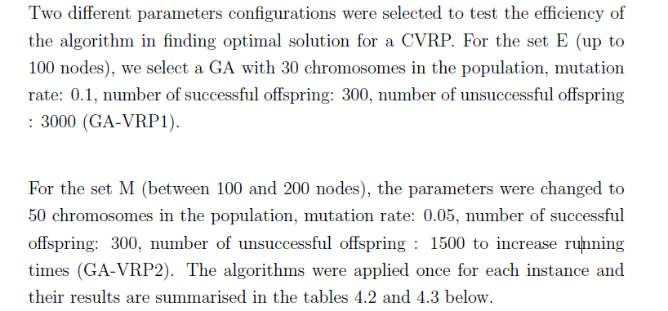
Heuristic – GA-VRP x Benchmark set: E
GA Configurations
Benchmark Results
Set
Notes:
Take advantage of the xpreso database -> Solvers that previously solve the problem
Try to improve their solution using the taffic congestion data / fuel emissions
Why not the rest?
Exact – Too time consuming
Not practical for more than 75 nodes
Other heuristics-
Population searches – Our case is to improve a known solution to a possible better optimum point
Fast , feasible 3 months, usable.

Slide 39
Heuristic – GA-VRP x Benchmark set: E
GA Configurations
Benchmark Results
Notes:
Take advantage of the xpreso database -> Solvers that previously solve the problem
Try to improve their solution using the taffic congestion data / fuel emissions
Why not the rest?
Exact – Too time consuming
Not practical for more than 75 nodes
Other heuristics-
Population searches – Our case is to improve a known solution to a possible better optimum point
Fast , feasible 3 months, usable.

Slide 40

Results

Slide 41
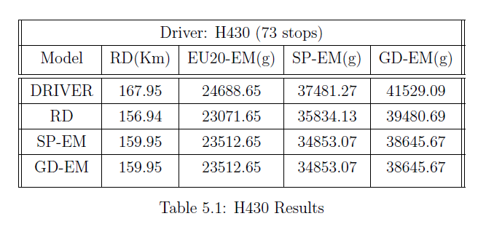
Results TSP - H430

Slide 42
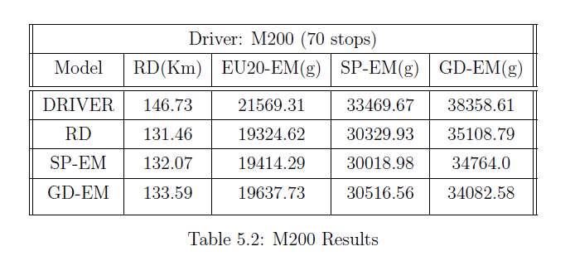
Results TSP – M200

Slide 43
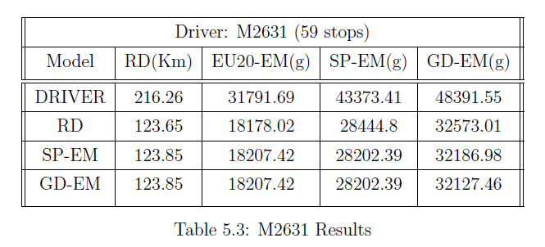
Results TSP – M2631

Slide 44
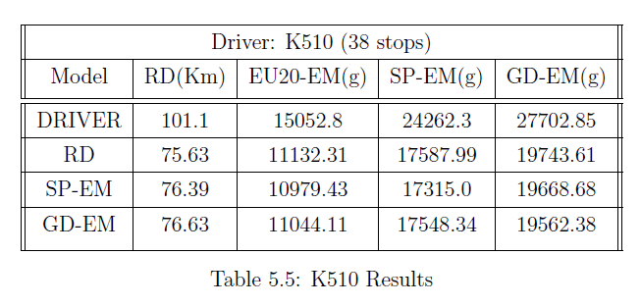
Results TSP – K510

Slide 45
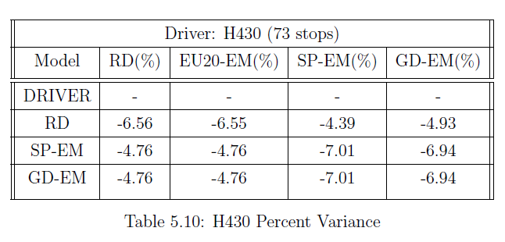
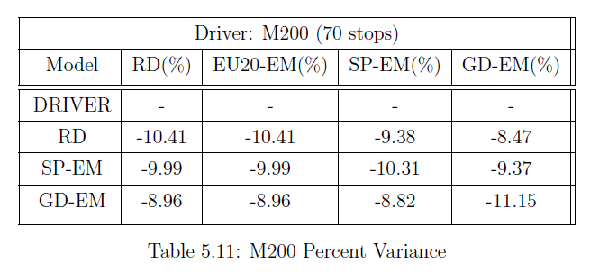
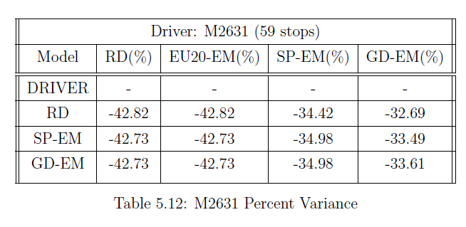
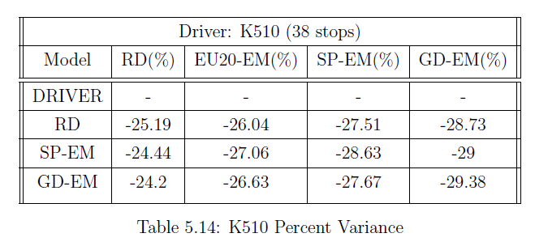
Results TSP – Percent Variance

Slide 46
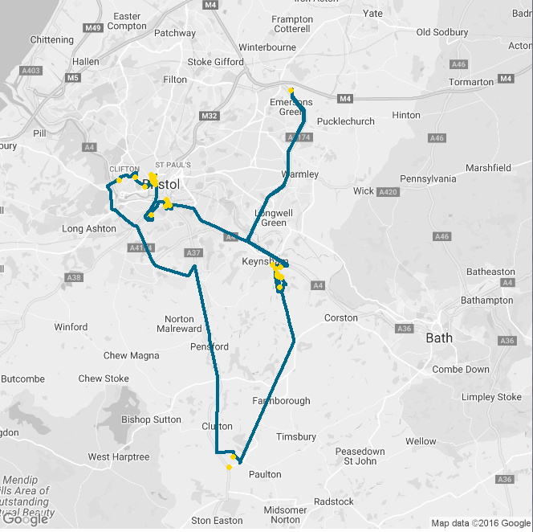
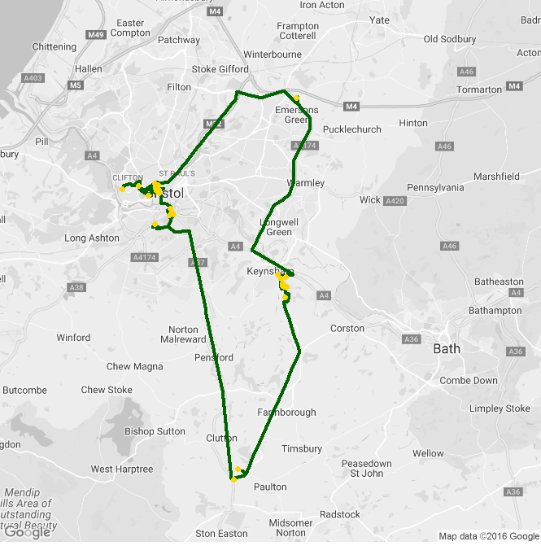
Results TSP – Tour K510
Real Tour
Green Tour
Depot
CO₂
Depot
CO₂
CO₂

Slide 47
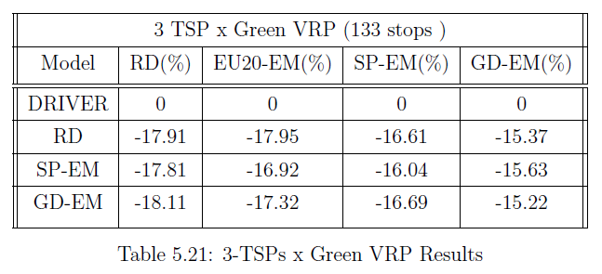
Results TSP vs VRP ( 2 drivers)
TSP
VRP

Slide 48
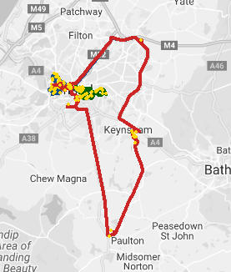
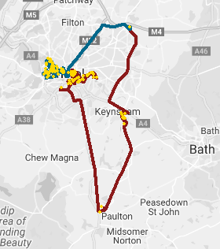
Tours TSP vs VRP (133 stops)
3TSPs
VRP (2 drivers)

Slide 49

Fuel Equivalence
$$CO2 per Litre of Diesel burned\left(Kg\right)=2.67 (Kg)$$
DIESEL

Slide 50
Fuel Equivalence
Assuming:
On Average 31 Kg of CO₂ per route…
On Average Savings around 30% in terms of emissions…
Diesel fuel price per litre: 1.22 € ….
5
DAY
A
WEEK
4
W
E
E
K
S
20
☓
☓

Slide 51

Fuel Equivalence
Assuming:
On Average 31 Kg of CO₂ per route…
On Average Savings around 30% in terms of emissions…
Diesel fuel price per litre: 1.22 € ….
5
DAY
A
WEEK
4
W
E
E
K
S
1700€
Savings
Per Month
20
☓
☓
→

Slide 52
Fuel Equivalence
CO₂
Assuming:
On Average 31 Kg of CO₂ per route…
On Average Savings around 30% in terms of emissions…
Diesel fuel price per litre: 1.22 € ….
CO₂
5
DAY
A
WEEK
4
W
E
E
K
S
1700€
Savings
Per Month
20
☓
☓
→
CO₂

Slide 53

Fuel Equivalence
Please consider the large scale impact of emissions based route optimisation
CO₂
CO₂
CO₂

Slide 54
Fuel Equivalence
Please consider the large scale impact of emissions based route optimisation
The example just mentioned would allow savings around
1390 Kg of CO₂ (each month) for a small fleet

Slide 55

Conclusion

Slide 56
Recommendation and Analysis
Conclusions
Solutions depend more on the Emission Model (EM) used;
Good Emissions TSP tours can increase road distance while they reduce the amount of CO2 emissions;
The savings in CO2 emissions can lead to reduced fuel costs for delivery companies;
VRP solutions (even suboptimal) can improve TSP tours (distance and CO2 emissions);
Competitive advantage can be achieved, by the usage of EM in route optimisation;
Further Opportunities
An EM using new technologies, engines and alternative fuels can produce better results in reducing emissions.
Post optimisation opportunities can be done by adjusting the emission via a suitable model using weights.
An ATSP solver can be used for asymmetric cost matrices. (RD, SP-EM, GD-EM);

Slide 57
Academic Contributions
Application of a heuristic method to the G-VRP with fuel emissions minimisation
Novelty and Impact
Application of a consolidated approach to a partially unexplored problem.
Usage of Emission Models for fuel consumption.
Test the efficiency of the method on a real-word database.
Quantify and conclude on the results
G-VRP

Slide 58
Business Contributions
Operations
Apply and measure a new method for solving the G-VRP problem
Compare with current solutions
G-VRP
Provide a method for reducing fuel consumption and emissions
EU 2020 Target: Reducing greenhouse gas emissions by 20% compared to 1990 levels
Environmental/social
-Costs/+Revenue
Reduce energy consumption costs
Creation of value
Government funding
Available to companies that apply environmentally friendly practices

Slide 59
Thank you for your
kind attention!
Questions?

